Slide 1
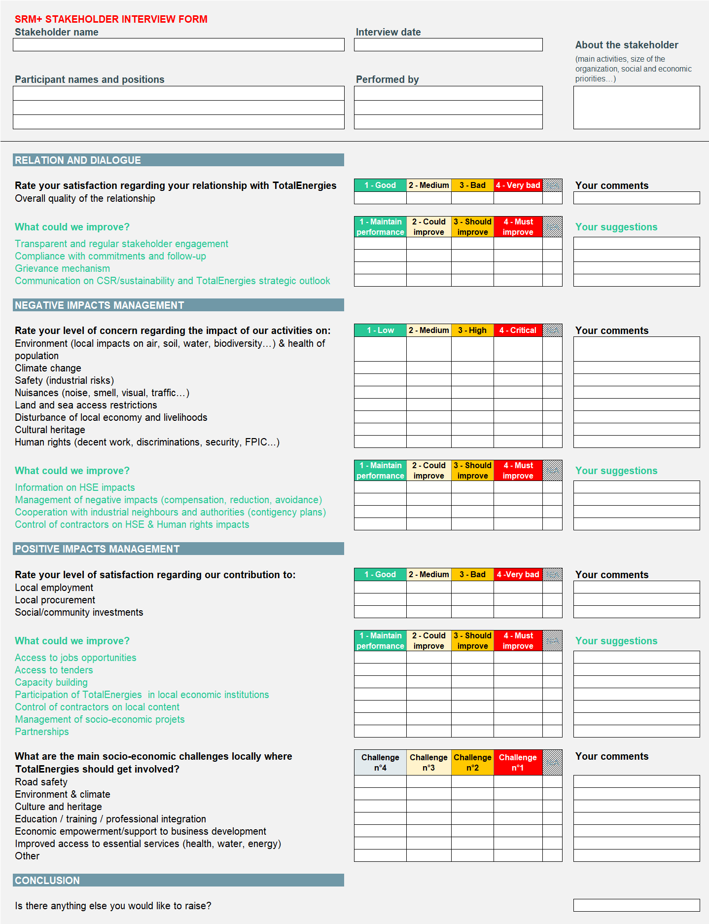

INTERVIEW GUIDELINES
SRM+
Stakeholder Relationship Management
HOW TO START THE INTERVIEW
1
Start by presenting the objectives of SRM+
Thanks for welcoming us
I would like to introduce our team…
This stakeholder dialogue approach is being implemented worldwide and is not specific to TEEP Brunei
Our purpose through stakeholder dialogue is to make sure that our CSR policy and actions plans meet priority expectations among our key stakeholders
You are one of our key stakeholder
Your comments and suggestions are welcome and will definitely help us to improve.
2
Explain how the interview works
The interview will last about 1 hour
We will discuss 3 main topics :
Quality of the relationship with TotalEnergies E&P Brunei
Impacts of our activities on Health, Safety, Environment and livelihoods
Contribution of TotalEnergies E&P Brunei to local economic and human development
For each topic, we will ask you to rate your level of satisfaction or concern and suggest possible actions that will help us to improve our performance
Don’t hesitate to skip to the next topic if you are not concerned by the topic or if do not wish to answer
3
Handover the booklet to the stakeholder that will help him follow the course of the interview
4
Ask the stakeholder to present himself and his organization (mission, objectives, size, CSR priorities if relevant)
SECTION 1 to 3
Each section is divided into 2 parts:
- The first part (in black) is assessing the stakeholder’s satisfaction or level of concern
- The second part (in green) is assessing and exploring TotalEnergies E&P Brunei priorities for improvement suggested by the stakeholder
Report the scores given by the stakeholder
Take notes of the comments and suggestions of the stakeholder
The third part contains a specific questions on social investment priorities for TotalEnergies
CONCLUSION OF THE INTERVIEW
Thank you very much for your time and answers.
It will be very useful to help us improve our societal strategy for the years to come
Do you any other issue or comment you would to raise?

Slide 2
INTERVIEW GUIDELINES
SRM+
Stakeholder Relationship Management
DO’S & DON’TS
Adopt a listening posture
Don’t be defensive, don’t argue with stakeholders
Accurately transcribe stakeholder comments
Comments are essential, do not rephrase them. Don’t suggest possible actions to stakeholders if they don’t mention them.
Ask stakeholders to score their perceptions directly
Scores help stakeholders to prioritize their concerns and expectations and avoid a shopping list effect
Respect the one-hour time limit
Do not create "fatigue" among the stakeholders
Commit to providing feedback to stakeholders
We will keep them informed of the results of the consultation
CONFIDENTIALITY
Some stakeholders might raise concerns regarding confidentiality
Reassure them by saying that comments will be kept anonymous if they asks for it (their name will not be disclosed in the report)
Comments they make are for internal purpose only to help TotalEnergies improve its CSR strategy and management of its relationship with stakeholders

